Slide 1
Credit One: Loan Approval Prediction Model in Python
Presented by Liliana Lopez

Slide 2
How Data Science Is Transforming Business
The rapid increase in data being collected and stored brings transformative benefits to organizations by turning data into a competitive advantage. There are numerous factors that go into determining if someone should be approved and how much of a credit line should be extended.
Two basic risks exist:
Financial loss that results from approving a bad candidate
Business loss that results from not approving a good candidate
Notes:
A written statement of the goal(s)
A well-defined data science process framework and the reasons you are proposing it
Descriptions and location of related data sources
An explanation of how you will manage the data for the project
Any known issues with the data and how you plan to address them
A flowchart visualizing the detailed process you will follow, annotated with any potential pitfalls you’ve identified and your proposed solutions to such pitfalls.
Any initial insights you can glean from your quick look at the data.

Slide 3
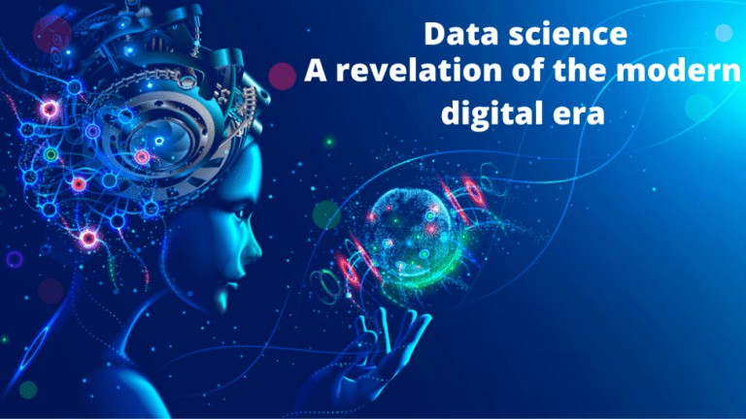
What is Data Science?
Data Science is a field that refers to the collective processes, theories, concepts, tools and technologies that enable the review, analysis and extraction of valuable knowledge and information from raw data.
Use of Data Science
Better decision making
To create as much impact as possible
Predictive analysis
To solve real problems
Pattern discovery
To make recommendations

Slide 4
BADIR : Framework to get from Data to Decisions
Business
Question
Analysis
Plan
Data
Collection
Derive
Insights
Recommendations
Data - from inquiry to insights
Decision - from insights to impact
Find the real
and actionable
Business question
Formulate a hypothesis-driven Analysis plan
Collect relevant
Data based on
the Analysis Plan
Derive Insights using machine learning & statistics
Drive KPI’s
with actionable Recommendation

Slide 5
Find the real and actionable Business question
Business Question
Credit One wants us to examining current customer demographics to better understand what traits might relate to whether or not a customer is likely to default on their current credit obligations, or at a minimum determine if a customer is eligible for a credit line.
The intent underlying the question is vital to the success of Credit One because their business model depends on customers paying their debts.
Credit One should take into consideration any business loss that results from not approving a good candidate and the financial loss that results from approving an ‘at-risk’ candidate.

Slide 6
Formulate a hypothesis-driven Analysis plan
Analysis Plan
What is the analysis goal? To use Python and some related data analytics and machine learning libraries to explore patterns in our customer data and to create predictive models which forecast whether a credit line should be approved or not based on some attributes of the customer.
PROJECT PLAN
ANALYSIS GOALS
ANALYSIS
PLAN
DATA
SPECIFICATION
What hypotheses are to be tested? Analyze the data, to infer the patterns, and to make predictions to identify which customer traits Credit One can use to better classify potential customers as being ‘at-risk’ and determine:
HYPOTHESIS
METHODOLOGY
how much credit to allow someone to use.
if someone should be approved or not.
whether or not a customer is likely to default on their current credit obligations.

Slide 7
Formulate a hypothesis-driven Analysis plan
Analysis Plan
What data is required/available to test the hypotheses?
Available data: Credit One dataset consists of 30,000 rows, representing 30,000 customers with a credit line in the last six months and 25 variables in total. Some of the customer attributes include gender, level of education, marital status, and age.
Required data: Additional attributes like the customer’s income level, rent or mortgage payments, years of employment, and other significant debt and loans can be used to better classify customers.
What methodology(-ies) will you employ? Explore the structure of the data, we will build a predictor model by using well-known pre-processing methods such as imputing missing values, variable names, data types and finally applying the model on training data set and evaluating the performance of classification algorithms like Decision Tree and Random Forest.
What is the project plan? The iterative process for this predictive model will consist of understanding and defining the problem, analyzing and preparing the data, applying the algorithms, reducing the errors, and predicting the result.

Slide 8
Collect relevant Data based on the Analysis Plan
Data Collection
From where can the data be obtained? Data set information was obtained from Credit One MySQL database, which is a third-party credit rating authority that provides retail customer credit approval services to Blackwell.
How must the data be cleansed and validated? Cleaning data means making it ready for analysis with the given tools and methods being used. Check for anything that might not work in a math equation or setting - things like symbols, null values and even missing data needs to be searched for. Additionally, converting data types, removing duplicate data, and enriching the data to benefit Credit Care.
Notes:
From where can the data be obtained?
How must the data be cleansed and validated?

Slide 9
Derive Insights using machine learning & statistics
Derive Insights
What patterns do you see in the data? Explore the data, to validate patterns in the data if there is a real problem and if there are unusual patterns in key variables.
Are each of the hypotheses proven or disproven? Examine the relevant data needed to prove or disprove each one in order to identify the one(s) that answers Credit One business question.
How much confidence should stakeholders place in the results? Findings will be presented in terms of quantified impact to guide prioritization of the hypothesis.
Notes:
What patterns do you see in the data?
Are each of the hypotheses proven or disproven?
How much confidence should stakeholders place in the results?
How do you rank your findings in terms of quantified impact on the business?

Slide 10
Drive KPI’s with actionable Recommendation
Recommendations
How can you most effectively present the results of your analysis to your stakeholders? A number of strategies can be used to communicate results that help the stakeholders to understand the findings and implications of an analysis.
Some key components are:
Tailor the message to the audience.
Focus on the business problem, the implications, and solutions.
Tell the story in a way the audience can understand.
Use nontechnical language and avoid acronyms
Use visual displays and effective visual cues.
Keep chart titles and data labels clear, concise, and meaningful.
Prepare a compelling conclusion.
Notes:
How can you most effectively present the results of your analysis to your stakeholders (in terms they can understand and in alignment with information they’ll value)?
Note: A generic template for a recommendation presentation or report might include:
Objective:
- Background (optional)
- Scope (optional)
- Approach (optional)
- Recommendations
- Key insights with impact
- Next steps

Slide 11
BADIR : Framework to get from Data to Decisions
B
Business Question
Find the real and actionable Business question
A
Analysis Plan
Formulate a hypothesis-driven Analysis plan
D
Data Collection
Collect relevant Data based on the Analysis Plan
Data - from inquiry to insights
Decision - from insights to impact
I
Derive Insights
Derive Insights using machine learning & statistics
R
Recommendations
Drive KPI’s with actionable Recommendation

